Slide 1
Shipping Gateway
Logistics Case Study

Slide 2


Agenda
SG
Shopping Mall
Payment Gateway
Booking.com/Trip Advisor
Shipping Gateway – Problem statement
UI design/Flow diagram
High level Design
Public API Integration

Slide 3
Business opportunities are like buses. There's always another one coming.
“
”
Richard Branson

Slide 4
Original Concept
Shipping Gateway is a concept inspired from Open Banking, Payment Gateway, Managed Shipping, Shopping Mall. After enabling this option will give better opportunity for logistics companies to generate revenue and customer get facility to select desired shipping service based on quality and affordable services while purchasing things online through e-commerce channel. Win-Win situation for both logistics companies and e-commerce customer. Also, standardized the entire process or platform.

Slide 5
Primary goals
Provide Standard platform where leading logistics companies can generate revenue and provide better option for customer while shipping their goods ordered through online channels

Slide 6
Meet our team (for POC)
Abhijeet Mukkawar​
​
Original Concept
iOS developer/POC implementer
Android developer

Slide 7
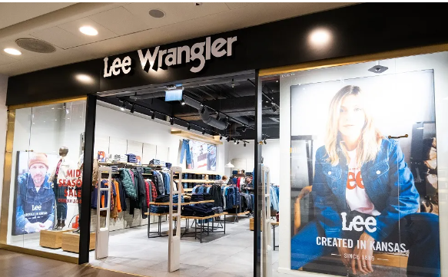
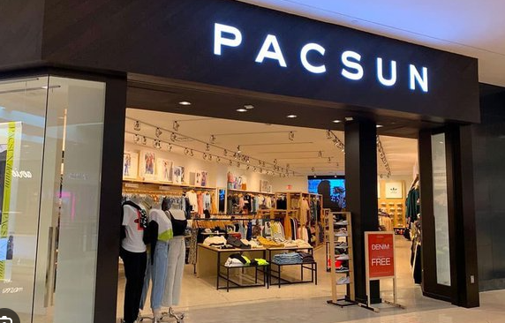
Shopping Mall
Core Concept
Shopping centers play an important role in communities by providing a central location for people to shop, socialize, and access services
Business Benefits
Renting retail space in a mall allows a business owner to attract clients of competitors who have shops in the same mall.

Slide 8
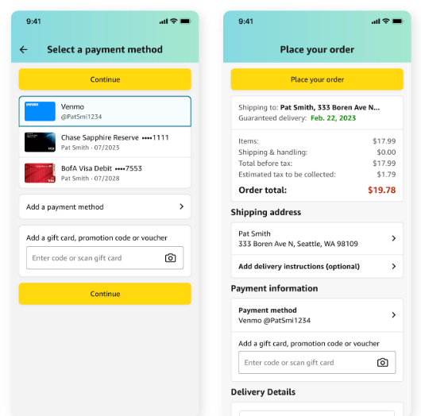
Payment Gateway
PG
How it works
The payment gateway is a key component of the electronic payment processing system, as it is the front-end technology responsible for sending customer information to the merchant acquiring bank, where the transaction is then processed
A payment gateway is a digital payment service that is used as a channel to make and receive payments.

Slide 9
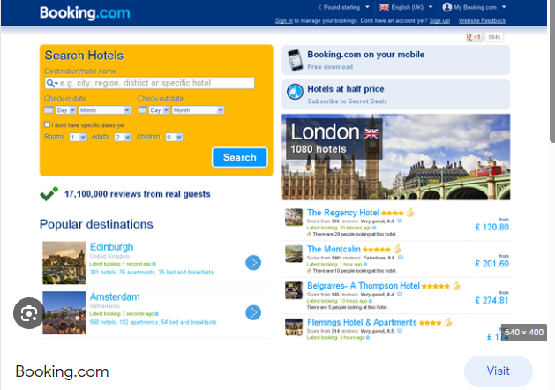
Booking.com & Trip Advisor
PG
How it works
Booking.com is an online booking platform that mediates between hotels, guesthouses, vacation rentals and their guests. Hotels and hosts offer their accommodation through the website and mobile apps. Travelers can use the search function to set what they are looking for and book directly
Catch here
.
Booking.com is mediator between travelers and hotels and providing single platform for hotels and customer can book hotel in affordable rates

Slide 10
Shipping Gateway -
What we are trying to solve
Currently, e-commerce business has to tie-up with logistics partners to ship their customer’s deliveries and business must integrate public APIs into their Application.
Customer has no choice for selecting logistics for shipping their goods/product as they must rely on merchants.
Even it’s trouble for logistics companies also to tie up with each business who wish to select them as logistics partner
With Shipping gateway, it can provide common platform where all logistics brand can come together and do their business and seek for profitability.
With Shipping gateway, customer gets extra advantage to select logistics based on Brand, Quality and Affordability
Additional channel will be opened for logistics companies to generate more revenue out of it as e-commerce businesses are already on it’s peak.
Brand value can be elevated through this gateway concept.
Ecommerce Merchant can focus on their core businesses and no need to worry on managing shipping for customer
Target is to have seamless shopping experience by enabling loosely coupled services.

Slide 11
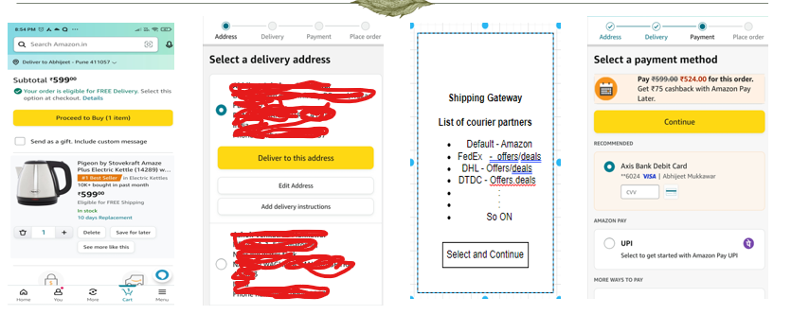
Shipping Gateway

Slide 12
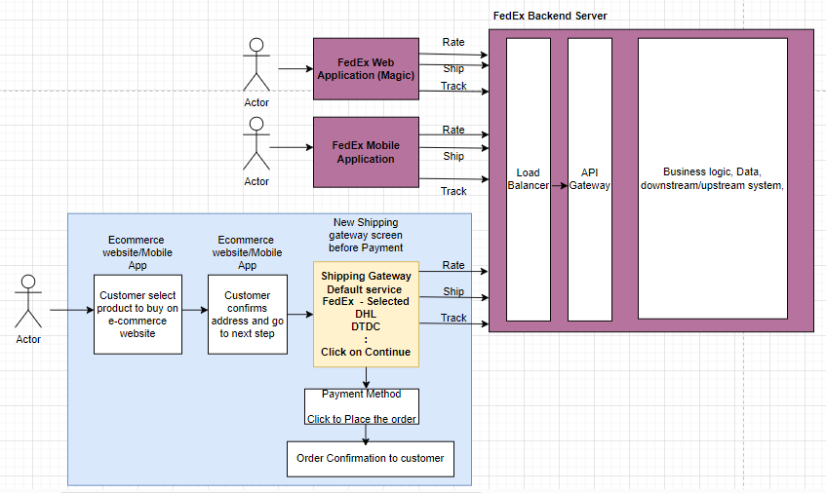
High Level System Design

Slide 13
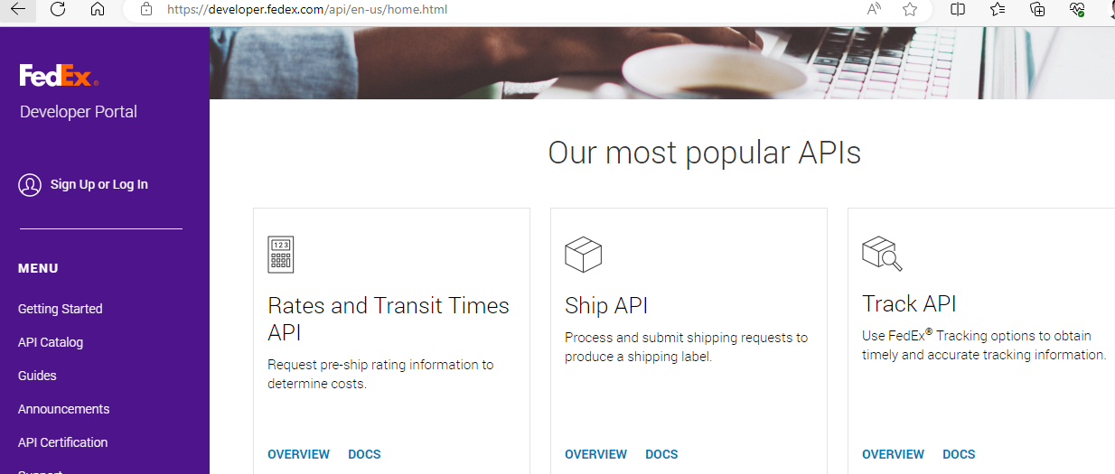
FedEx Developer portal (FedEx APIs and Developer Portal)

Slide 14
Next Step
Proof of concept preparation

Slide 15
Thank you
Abhijeet Mukkawar
abhijeet.mukkawar@eviden.com

